Slide 1
Introducing BIOMATERIALS

Slide 2
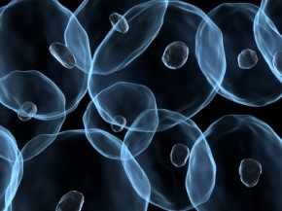

Teachers in Residence Programme
Iseult Mangan and Tom Flanagan
Notes:
Image: http://www.celldataservices.co.uk/biomaterials

Slide 3
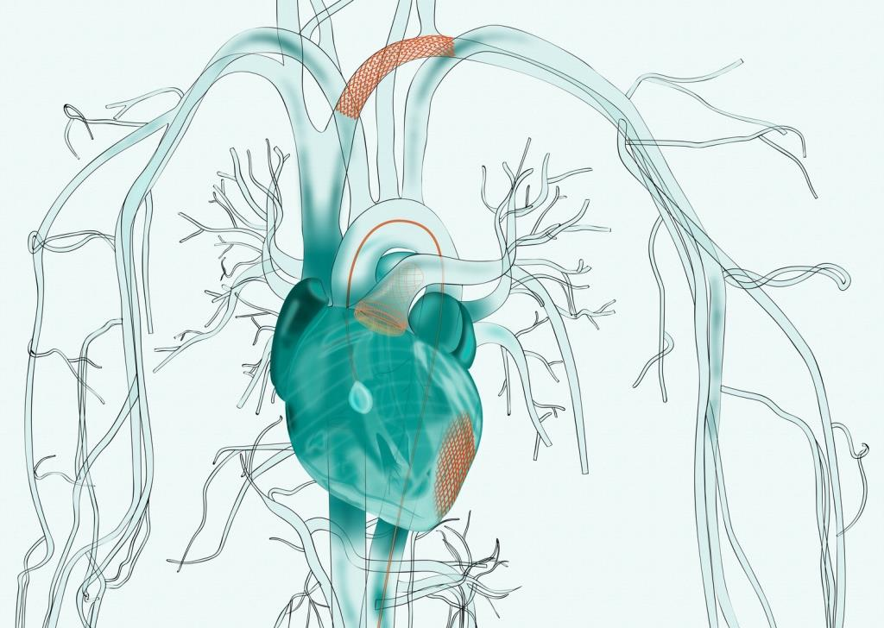
MEDICAL DEVICES
Any material, apparatus, software or other article that is used to:
Diagnose, prevent, monitor or treat a disease or injury
Investigate, replace or modify a part or process of the body

Slide 4
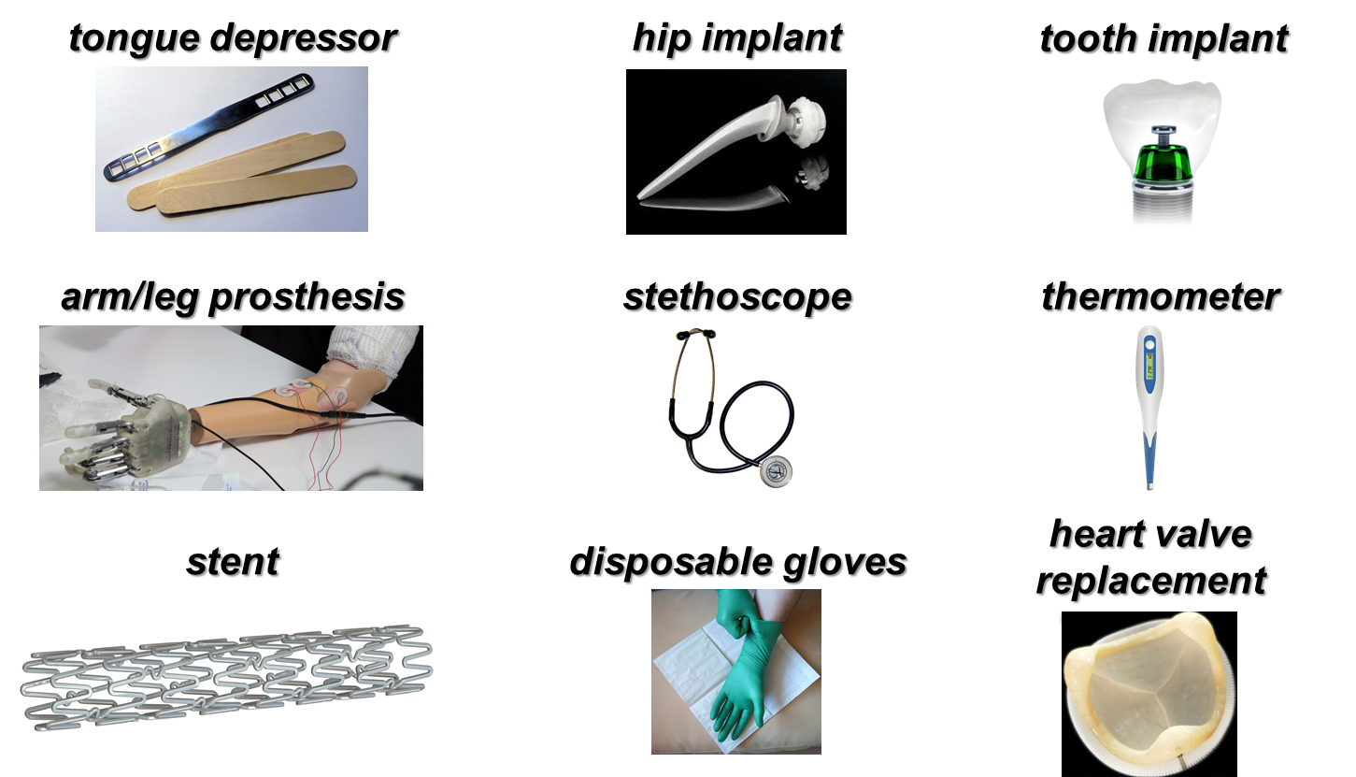
CAN YOU NAME SOME
MEDICAL DEVICES?
Notes:
https://upload.wikimedia.org/wikipedia/commons/0/00/Stainless_steel_and_ultra_high_molecular_weight_polythene_hip_replacement_%289672239334%29.jpg
https://upload.wikimedia.org/wikipedia/commons/0/0f/Mundspatel.jpg
https://upload.wikimedia.org/wikipedia/commons/d/d7/Stethoscope.png
https://pixabay.com/en/thermometer-digital-temperature-36852/
https://www.flickr.com/photos/campusbiomedico/12326026754
https://vimeo.com/8316149
https://upload.wikimedia.org/wikipedia/commons/5/59/Surgical_gloves_27.JPG
https://upload.wikimedia.org/wikipedia/commons/a/af/Kovovej.png
https://upload.wikimedia.org/wikipedia/commons/2/23/Teeth.jpg

Slide 5
Biomaterials are used to make
medical devices
What are BIOMATERIALS?

Slide 6
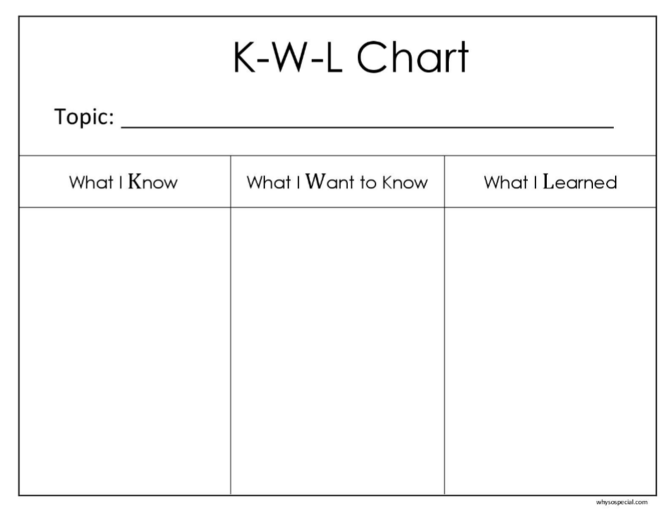
Biomaterials

Slide 7
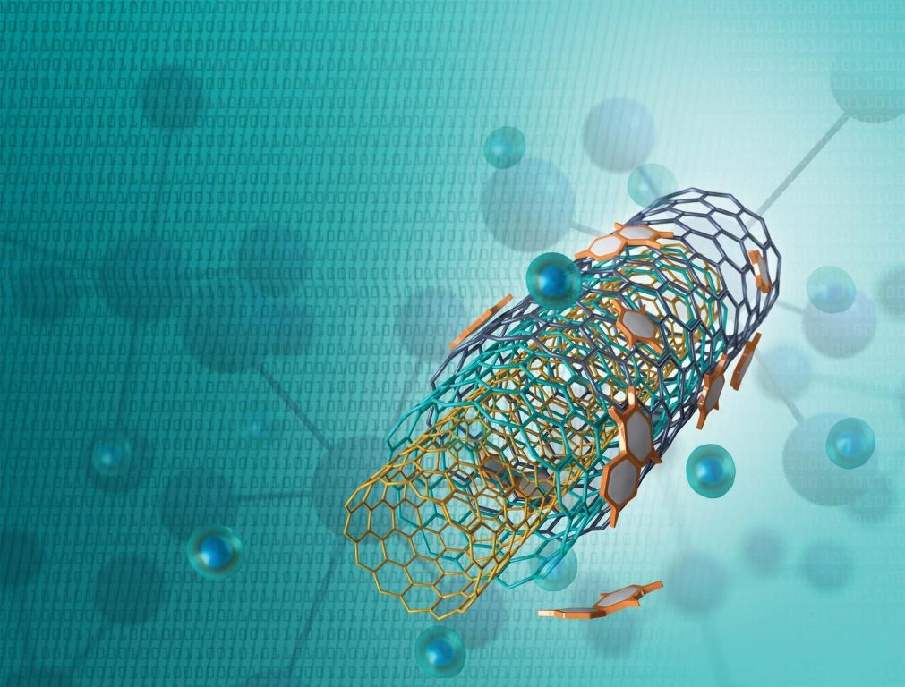
WHAT ARE BIOMATERIALS?
A biomaterial is made from a natural or synthetic material that can be engineered to help the body heal itself
A biomaterial can be introduced into the body as part of a medical device or used to replace an organ
A biomaterial can be temporary or permanent

Slide 8
Must have appropriate physical properties for the area of the body they are being used
Can easily be made into a shape of choice
Must be noncarcinogenic
Must be nontoxic
Must be biocompatible
Biomaterials

Slide 9
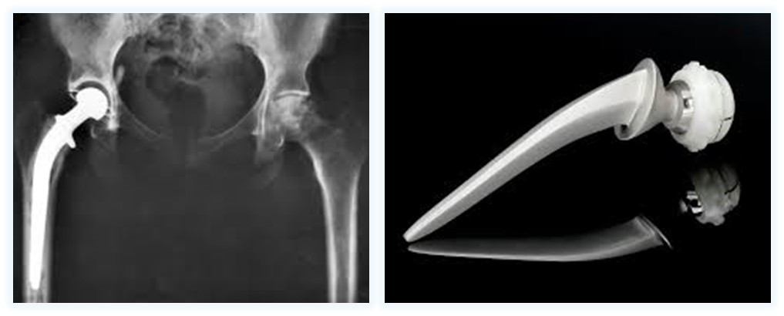
SYNTHETIC BIOMATERIALS
Materials made by humans, like plastic or metal
Good:
They are easy to make and exactly the way you need
Bad:
Sometimes the body does not like them
Notes:
https://upload.wikimedia.org/wikipedia/commons/2/2f/Hip_replacement_Image_3684-PH.jpg
https://upload.wikimedia.org/wikipedia/commons/0/00/Stainless_steel_and_ultra_high_molecular_weight_polythene_hip_replacement_%289672239334%29.jpg

Slide 10
SYNTHETIC BIOMATERIALS
Type | Where would you use them in the body? | Examples
Metal | Hips, knees, shoulders, ankles | Wires, screws, plates, artificial joints, stents
Polymer | Face, trachea, kidney, liver, heart, teeth/dentistry, hips, knees | Tubes, dentures, adhesives, sealants, sutures, coatings
Ceramic | Teeth/dentistry, joints | Crowns, dentures, artificial joints, bone repair
Composite | Teeth/dentistry, limbs | Prosthetic limbs, dental cement, crowns

Slide 11
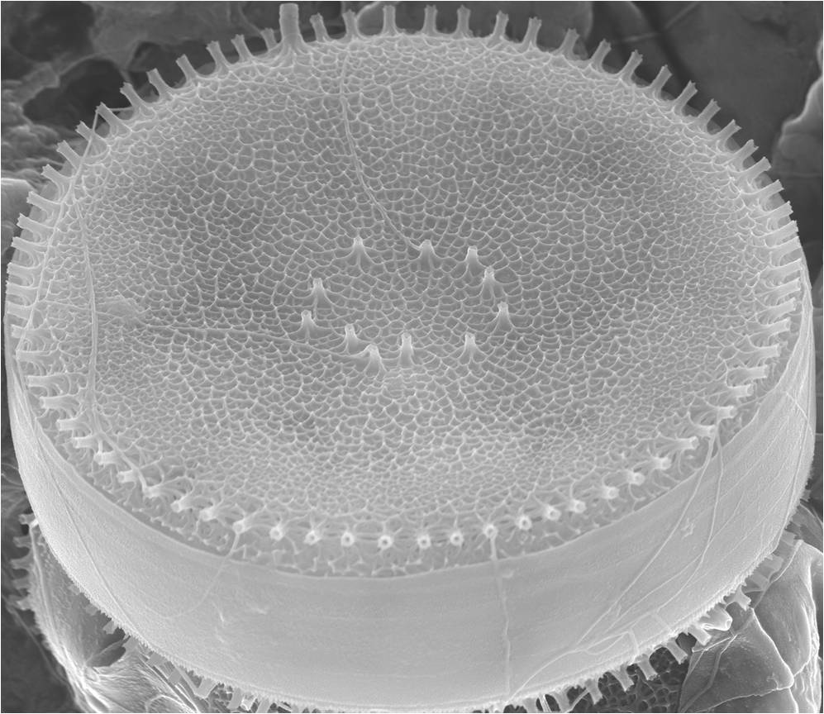
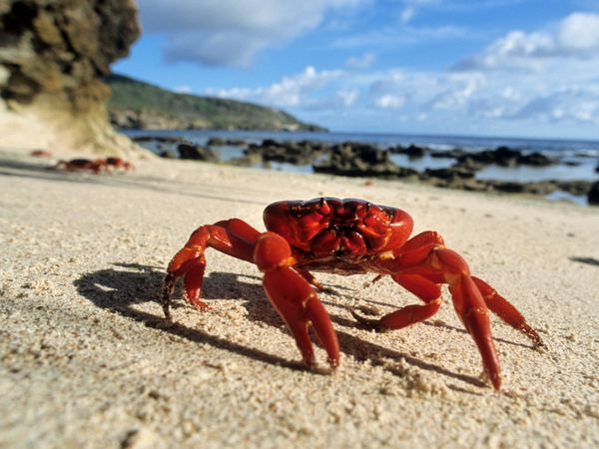
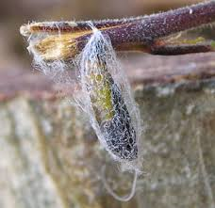
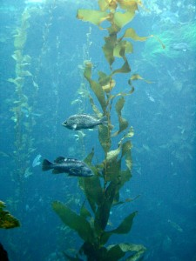
NATURAL BIOMATERIALS
Materials from nature and made from cells
Algae found in freshwater and seawater
Shells of crabs and prawns
Silk from butterfly
cocoons
Alginate from seaweed
Good: The body likes them Bad: People can’t make them
Notes:
http://www.gojiberryblog.com/2011/09/11/how-to-revive-your-plants/
http://gpwalsh.com/the-shift/
http://animals.nationalgeographic.com/animals/invertebrates/red-crab/

Slide 12
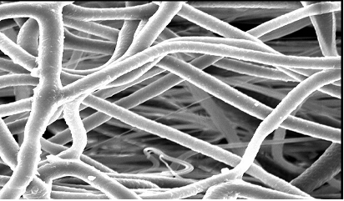
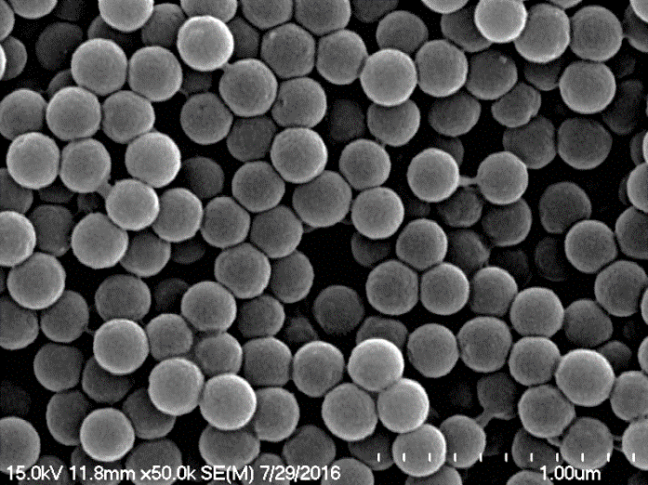
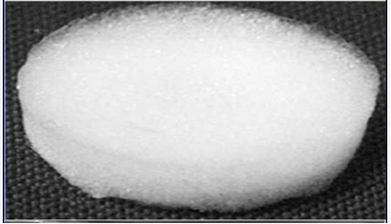
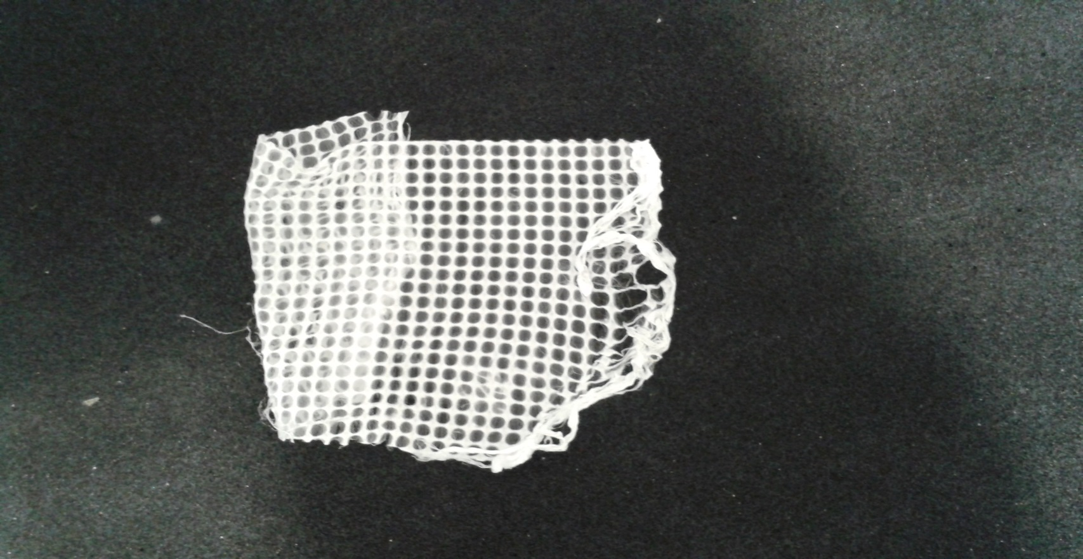
Fibres
Nanospheres
Biomaterials can take many forms
to support new tissues to grow
Sponges
Meshes

Slide 13
Fibres
Nanospheres
Some biomaterials are soft and jelly-like and can be injected into the brain or heart.
WHY DOES IT NEED TO BE SOFT?
Sponges
Meshes
Notes:
The biomaterial must be soft and jelly-like so that 1) it is easily injectable, and 2) is the same consistency as the tissue it is going into.
A harder biomaterial would need to be made if a harder tissue was being treated (bone).

Slide 14
Activity: Make a Biomaterial
Biomaterial
½ Teaspoon Optrex eyewash
½ Cup PVA glue
1 Teaspoon bread soda
2 Tablespoons paint

Slide 15
EVALUATION
1.) Draw a picture of the biomaterial that you created.
2.) Do you think that the biomaterial was created successfully? Why or why not?
3.) If you were making the biomaterial again, what would you do differently?

Slide 16
Biomaterials

Slide 17


Slide 18
References:
Handbook of Materials for Medical Devices, 2003 ASM International
“Milestones in Medical Technology,” New York Times, Published October 10, 2012
www.celldataservices.co.uk/biomaterials
commons.wikimedia.org
www.flickr.com
www.pixabay.com
vimeo.com
www.gojiberryblog.com/2011/09/11/how-to-revive-your-plants/
gpwalsh.com/the-shift/
animals.nationalgeographic.com/animals/invertebrates/red-crab/
Sincere thanks to all of the researchers who gave lectures and generously gave their time throughout the course.
Thanks also to all the participating teachers who very kindly shared ideas and resources.

Slide 19







This publication has emanated from research conducted with the financial support of Science Foundation Ireland (SFI) and is co-funded under the European Regional Development Fund under Grant Number 13/RC/2073.
This project has been funded by the European Union Seventh Framework Programme under Marie Curie Initial Training Networks (FP7-PEOPLE-2012-ITN) and Grant Agreement Number 317304 (AngioMatTrain). This project has also been funded by the European Union Horizon 2020 Programme (H2020-MSCA-ITN-2015) under the Marie Skłodowska-Curie Innovative Training Networks and Grant Agreement Numbers 676408 (BrainMatTrain) and 676338 (Tendon Therapy Train).

